Slide 1
Judith E. Heumann
Disability Rights: The American Experience
Special Advisor for International Disability Rights

Slide 2
Before the ADA: Segregation and Exclusion
Strong Parent Advocates
Weak DPOs
Segregated Education
Institutions
Discriminatory Laws
Low Expectations
Job Discrimination

Slide 3
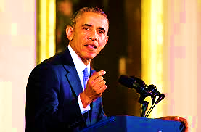
The U.S. Today: A Nation Transformed
"Thanks to the ADA, the places that comprise our shared American life -- schools, workplaces, movie theaters, courthouses, buses, baseball stadiums, national parks -- they truly belong to everyone."
— President Obama
Transportation
Healthcare
Accessible Environment
Employment
Education
Reasonable Modifications/ Accommodations

Slide 4
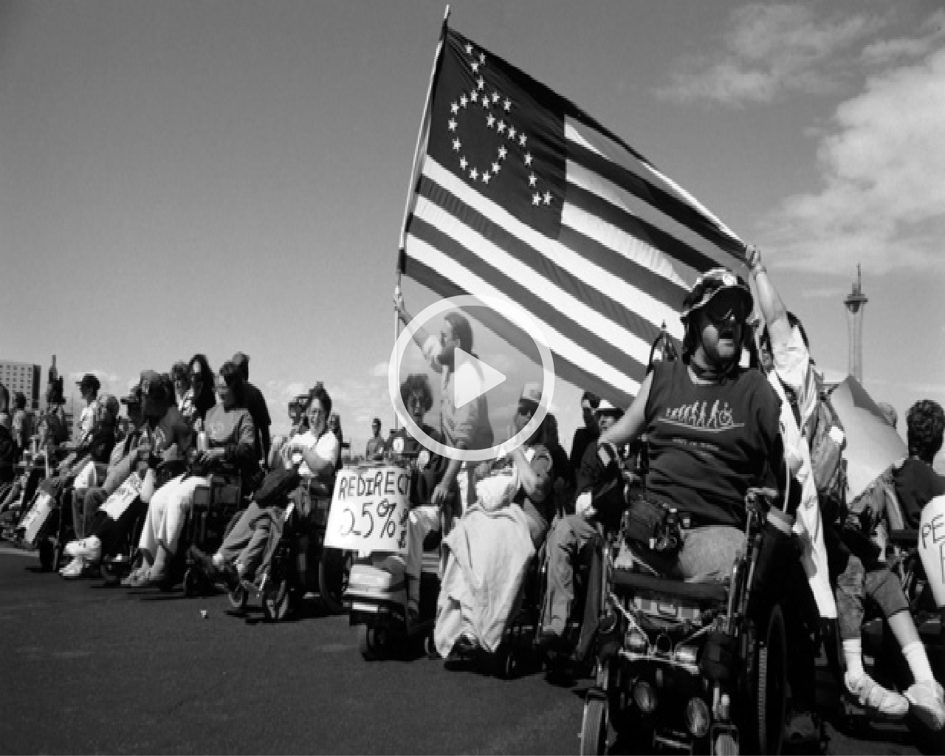
How We Got Here: The U.S. Disability Rights Movement
Video Clip from Lives Worth Living (2:36)

Slide 5
How We Got Here: The U.S. Disability Rights Movement
Organizing movement
Negotiations & Community Organizing
Protests & sit-ins
Public Awareness
Working with Government

Slide 6
How We Got Here: U.S. Legislation
Title V of the Rehabilitation Act of 1973
Individuals with Disabilities Education Act (IDEA)
Americans with Disabilities Act (ADA)

Slide 7
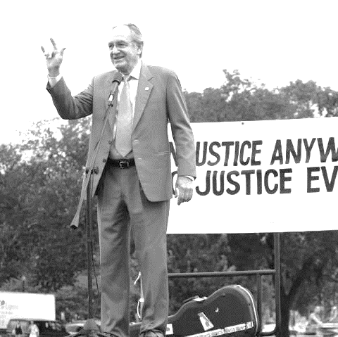
How We Got Here: Implementation: Role of Government
Government Consultation with DPOs
Clear regulations on implementation
Education and training
Technical Assistance
Integration of disability
throughout policy and practices
Senator Tom Harkin

Slide 8
How We Got Here: Implementation: Role of Civil Society
Knowing Your Rights
“healthy tension”
Enforcement
Complaints, Mediation, and Lawsuits
Advocacy

Slide 9
Government Leading by Example
Appointment of Key Positions
“Model Employer”
Key Leadership Public Support

Slide 10
Challenges & Opportunities
Maintaining Coalitions
Employment
Stigmatization
Continued reform and implementation

Slide 11
Change is possible – you can make it happen.

Slide 12
Judith E. Heumann
Special Advisor for International Disability Rights
HeumannJE@state.gov
Facebook/SAHeumann
@IntDisability

